Slide 1
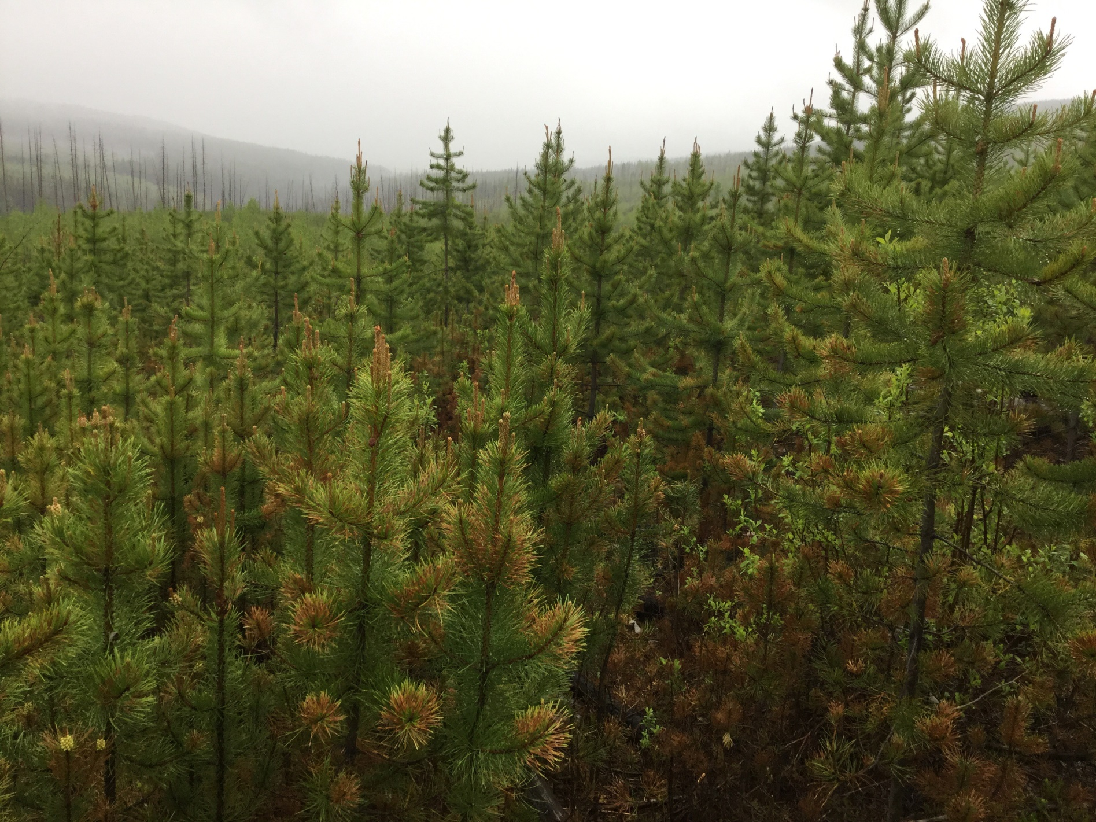
Repression Density
An update to the Interior Silviculture Subcommittee
November 24, 2021
Greg Jorgenson, Resource Practices Branch FLNRORD

Slide 2
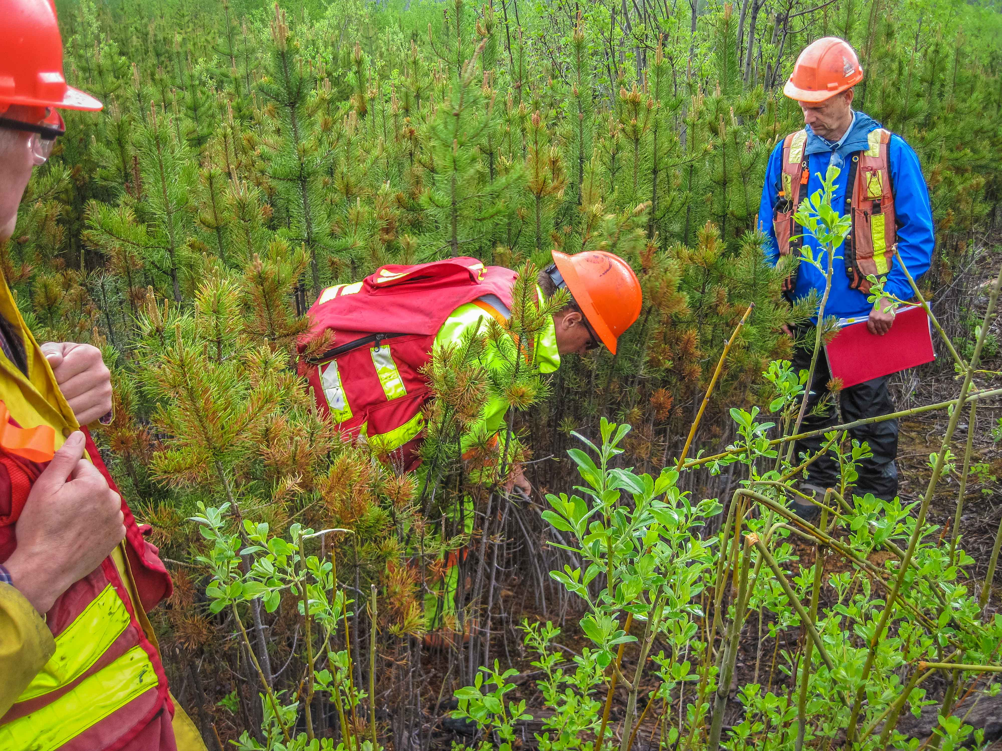
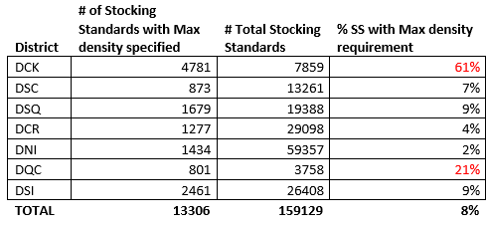
max density + coastal stocking standards
Notes:
working with the Coast Area to address the significance of maximum density in their area…just to recap…
we did a bit of an FSP sweep to look for maximum density requirements that were adopted by tenure holders: Chilliwack and Haida Gwaii represent the significant % of stocking standards with max density specified…
BUT…something like 10-15 ha has been treated over the last year or two.
this essentially is what supports the Coast OIF Stance on max density
They did not want to ‘endorse’ policy, per se stating it was awkward to do so, and it was not their role to create policy…
they did provide feedback through some key members suggesting JUVENILE SPACING has not been in practice for quite some time, the policy will not impact them etc etc, and self thinning and log quality are fine just the way they are…
The feedback came from one major licensee and one stewardship officer

Slide 3
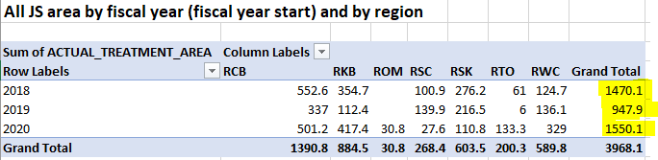
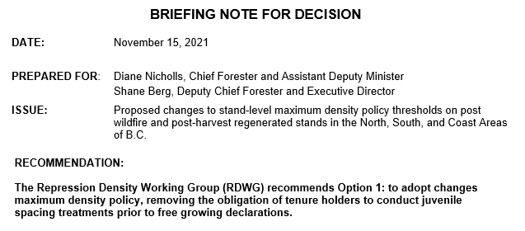
updated spacing stats
Notes:
new current spacing activities in the North and South reported to RESULTS , but filtered by BCTS and Industry Appraisal.
The number is very small---under 170 ha in the last 3 years…all funding sources combined are highlighted above …reported in 2021—FFT and FES mostly.
puts the magnitude of the spacing activities in context

Slide 4

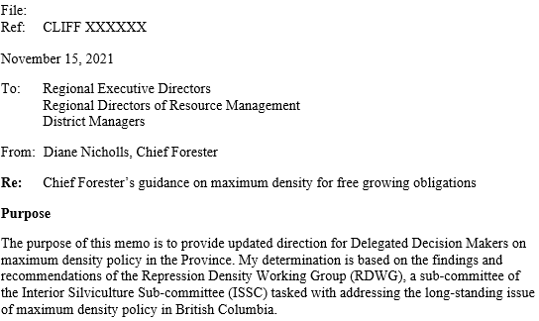

next steps
Decision Note
North Area OIF support
South Area OIF support
Coast Stewardship support
Coast Area OIF ‘support’
Chief Forester Policy (submitted for signoff)
Notes:
The Decision Note should be supported! We have checked off the last two boxes…almost….
The signoff and documentation process is two parts:
one: the DECISION NOTE adapted for Diane to review and endorse…and secondly
the MEMO FROM THE CHIEF FORESTER STATING THAT THIS IS PROVINCIAL POLICY…will be going up to her once we have the policy experts stamp of approval.
They are in the process of reviewing the policy changes because we have an overarching need to address the way the Chief Forester can issue guidance to DDMs for the approval of NEW FSP submissions…this is the easy route
But for existing FSPs, the policy specialists are reviewing the documents now, and we should have a path forward identified in the coming days

